Slide 1

iText 5
Dima Ionut Daniel

Slide 2
Contents
What is iText?
iText Goals
Why PDF?
iText Core
PDF Manipulation
Interactive PDF
Forms
Advanced PDF
Conclussion
Bibliography

Slide 3

What is iText?
iText is an open source library for creating and manipulating PDF files in Java.
From version 5.0.0 (released Dec 7, 2009) iText is distributed under the Affero General Public License version 3.
Previous versions of iText were distributed under the Mozilla Public License or the LGPL
iText has been ported to the .NET Framework under the name iTextSharp(written in C#).

Slide 4
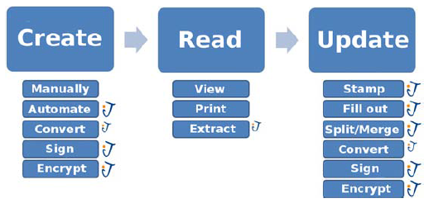
iText Goals
iText features:
Dynamically generate PDF documents from XML file or databases
Serve PDF to a browser
Use PDF interactive features
Add bookmarks, page numbers, watermarks, barcodes, etc.
Split, concatenate and manipulate PDF pages
Automate filling out PDF forms
Add digital signatures to a PDF file

Slide 5
Why PDF?
PDF is the Portable Document Format:
an open file format (ISO-32000-1), originally created by Adobe
used for documents that are independent of system software and hardware
essential part of the web
presents security features for protecting documents
contains metadata that make PDF documents easily searchable
PDF objects, especially images, can be highly compressed with different compression algorithms without a visible loss of quality

Slide 6
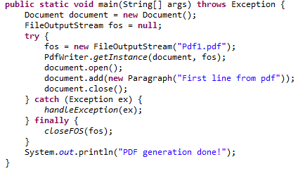
iText Core
Document is the object to which you’ll add content in the form of Chunk, Phrase,Paragraph, and other high-level objects.
We can define page size and page margins when creating the document using the Rectangle object.
PdfWriter is the class responsible for writing the PDF file.
DocumentException is the most general exception in iText.
By default, iText uses PDF version 1.4, which was introduced in 2001. The version can be changed as:
PdfWriter.getInstance(document, new FileOutputStream(RESULT)) .setPdfVersion(PdfWriter.VERSION_1_7)

Slide 7
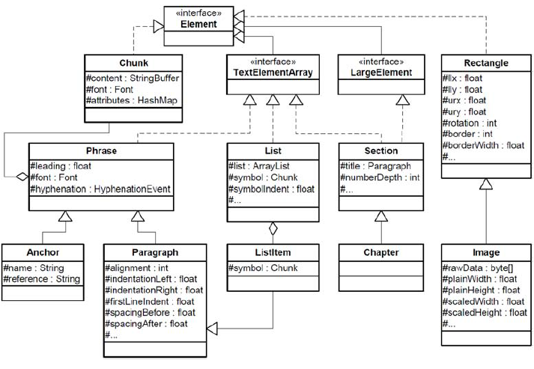
iText Core (cont.)
In the PDF-creation process the add() method is used to objects implementing the Element.

Slide 8
iText Core (cont.)
The Paragraph class represents a "paragraph" of text.
In a paragraph you can set the paragraph alignment, indentation and spacing before and after the paragraph.
We can add ordered and unordered lists to a PDF document using the class List.
List items are represented by the class ListItem.
We can write text as superscript or subscript using the Chunk class, and it's setTextRise() method.
Using a positive text will rise value for superscript, and a negative text rise value for subscript.
We can add underline and strikethrough text using the Chunk class, and its setUnderline() method.

Slide 9
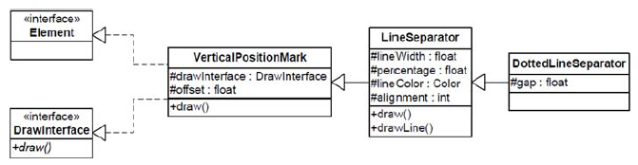
iText Core (cont.)
The DrawInterface interface is used for drawing custom elements.
The iText object corresponding to a form XObject is called PdfTemplate.
A PdfTemplate is a PDF content stream that is a self-contained description of any sequence of graphics objects.
PdfContentByte is an object containing the user positioned text and graphic contents of a page.
PdfTemplate extends PdfContentByte and inherits all its methods.

Slide 10
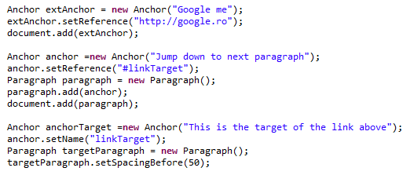
iText Core (cont.)
The Anchor class represents an link, either to an external website, or internally in the document.
The anchor (link) can be clicked just like a link in a web page.
The Image is used to add images to IText PDF documents.
You can load images either from file or from a URL.

Slide 11
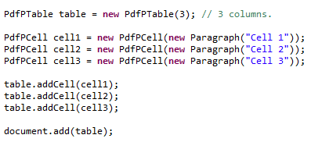
iText Core (cont.)
You can add tables to a PDF document using the PdfPTable class.
To add cells to the table we call the addCell() method, passing PdfPCell instances.
We can add a PdfTable as content inside a PdfCell, thus nesting tables within tables.
Usefull methods: setWidthPercentage, setSpacingBefore, setSpacingAfter, setColspan, setHorizontalAlignment, setVerticalAlignment, setLeading, setUserBorderPadding.

Slide 12
PDF Manipulation
PdfReader is used for reading PDF content.
PdfImportedPage is a read-only subclass of PdfTemplate.
PdfWriter is used to generate PDF files.
PdfStamper manipulates a PDF document.
PdfCopy is used to copy pages from one or more existing PDF documents.

Slide 13

Interactive PDF
PdfAction is used to create actions in PDFs.
An action can trigger JavaScript functions embedded in the document.
When adding the action to a Chunk, a rectangular clickable area is created.
The X and Y coordinate of the position were the clicked is made can be added to the URL as a query string if a second boolean parameter is invoked as new PdfAction("http://www.lowagie.com/", true).
JavaScript is also available in PDF viewers such as Adobe Reader.
Initially JavaScript 1.2 was used and since Acrobat 5.0, the API has been based on JavaScript 1.5.
The most recent versions of Acrobat and Adobe Reader (since 8.0) use JavaScript 1.6.

Slide 14
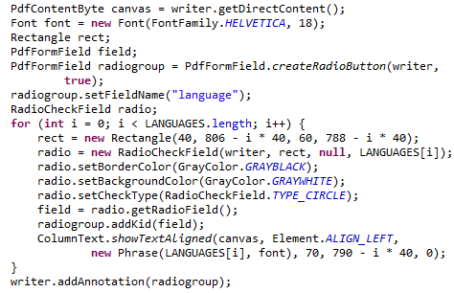
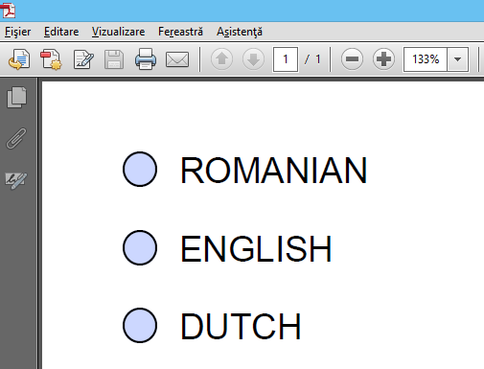
Forms
Adobe products support two ways to create, view, and fill out interactive PDF forms.
AcroForm technology: correspond to subclasses of the PdfObject object: PdfDictionary, PdfArray, etc.
XML Forms Architecture (XFA): created with the Designer tool that ships with Acrobat

Slide 15
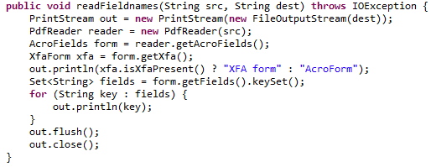
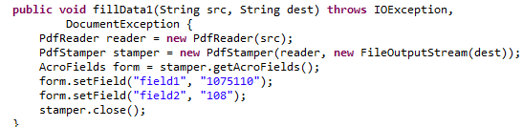
Forms (cont.)
Adobe LiveCycle Designer can be used to create XFA forms.

Slide 16
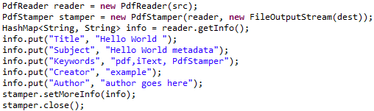
Advanced PDF
We can add metadata to PDF using the Document class.
Metadata fields: title, author, subject, keywords, creator.
The Extensible Metadata Platform (XMP) provides a standard format for the creation, processing, and interchange of metadata.
XMP was created by Adobe Systems Inc. and defines a model that can be used with any defined set of metadata items.
An XMP stream can be embedded in a number of popular file formats (TIFF, JPEG, PNG, GIF, PDF, HTML, and so on) without breaking their readability by non-XMP-aware applications.
iText will never compress an XMP metadata stream.

Slide 17
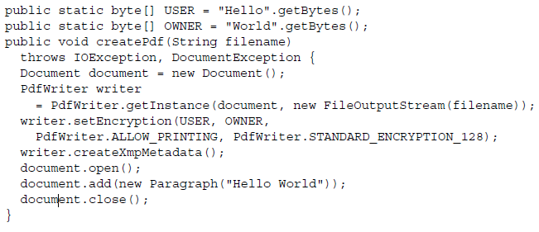
Advanced PDF (cont.)
We can setup to two passwords to be specified for a PDF document.
The standard encryption used in PDF documents is a proprietary algorithm known as RC4
Beginning with PDF 1.6, you can also use the Advanced Encryption Standard (AES).
iText supports the following algorithms: STANDARD_ENCRYPTION_40, STANDARD_ENCRYPTION_128, ENCRYPTION_AES_128.

Slide 18
Conclussion
iText is a PDF viewer and editor.
iText is free and documented.

Slide 19

Bibliography
http://www.simpopdf.com/resource/pdf-features.html
Manning – iText in Action 2nd Edition

Slide 20
Questions ?

